Slide 1
Synthetic face generation
Data 606: Capstone in Data Science
Professor: Chaojie Wang
Presented By:
Koushik Kumar Reddy Ajjuguttu - AR32779 Rama Charan Teja Polanki - DZ83376

Slide 2
Introduction
Synthetic face generation, is gaining a lot of attraction in current days.
Synthetic face generation has many applications like data augmentation for machine learning models, usage in anime or cartoons, creating social media influencers etc.
The technology behind this is GANs which is short for Generative Adversarial Networks.
Many firms and R&Ds started working on GANs extensively in recent days.
Facebook is extensively working on this to use the new faces in the metaverse.

Slide 3
Objective
The objective of this project is to create a data model which can synthesize images of faces which it has never seen.
The ML technology used for this purpose are GANs

Slide 4
Importance
Face synthesis can be used as a data augmentation technique in such cases to create more data.
Microsoft created a complete dataset with synthetic faces. When tested on different models, the performance was much better than models trained using normal dataset on test data.
Microsoft says this is because of the diversity added in the dataset.
This technology can be extended to gaming Industry for creating numerous game characters, government agencies to test the credibility of face recognition, IT industry to improve facial recognition to provide more privacy and security to their users.

Slide 5
Success stories
An artificially generated instagram influencer named Miquela Sousa got over a million followers on instagram before it was announced that she wasn't real. "Until my conversation with Nikola, it seemed like an indisputable fact that Miquela wasn’t real" - quoted by a reporter from "The Cut".
"The coolest idea in the last 20 years" - quoted by Yann LeCun
The success stories of GANs reflects on the impact they make in society.

Slide 6
Data collection
We obtained the dataset from "http://mmlab.ie.cuhk.edu.hk/projects/CelebA.html"
It is called the celebA dataset and contains over 200,000 face images along with different tags.
The data is from a trusted source which is Multimedia lab from The Chinese University of Hong Kong. The data contains faces with over 38 different attributes

Slide 7
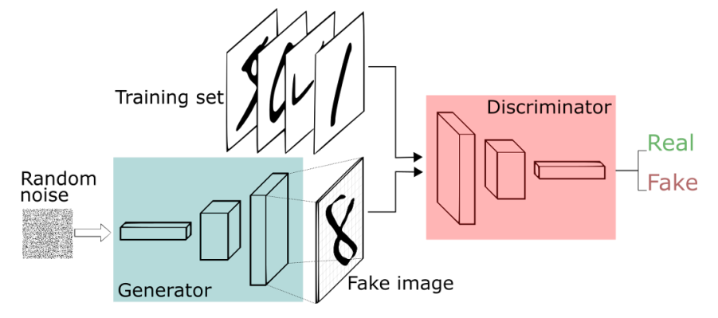
Model - Architecture

Slide 8
Model - Description
The model we are using is a Generative adversarial networks.
It contains a generator and a discriminator.
The generator takes an input and generates an image as an output
The discriminator takes an image as an input and gives true or false as output
Here true means it is a real image and false means it is a synthetic image
Both the generator and the discriminator are 2D convolution neural networks

Slide 9
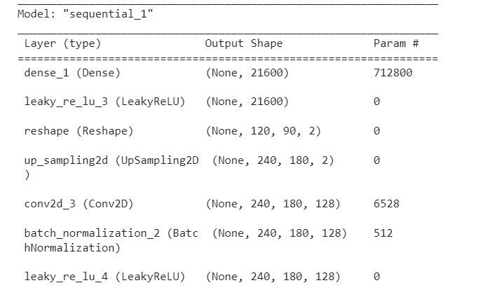
Model - Generator architecture

Slide 10
Model Architecture - Generator
The generator thales few inputs and acts similar to a decoder to generate the image
So we start with a 1D dense layer
We slowly increase the size of the dense layer
Reshape the dense layer to 2D
Apply smaller convolutions
Apply bigger convolutions finally to achieve an image of size expected

Slide 11
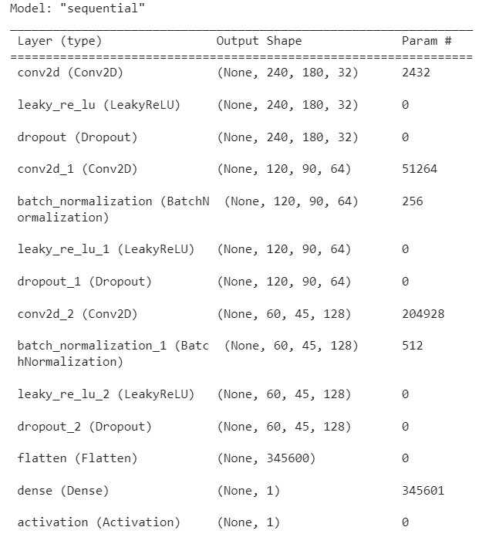
Model Architecture - Discriminator

Slide 12
Model Architecture - Discriminator
The discriminator starts with taking an image as an input
Then the layers follow like a normal image classification layers
We apply convolutions to get the resultant output size smaller and smaller
We increase the number of kernels slowly
Finally flatten all the neurons
Then apply dense layers until we get one output neuron

Slide 13
Implementation - Tech stack used
Python
Google colab
Keras
Opencv
Tensorflow
Numpy
Scikit learn

Slide 14
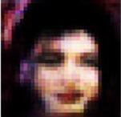
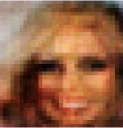
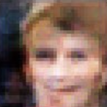
Faces created by the GAN

Slide 15
Problems faced
The generator and discriminator models were big enough
However the images that came out of the models were not so good enough
It could be found out that the images are synthetic
Reason: The models could not reach due to limited resources.
The models required repetitive batch trainings on images
Training once on images itself is heavily resource consuming
Training many times required a lot of time which never allowed the model to converge fully
Solution: The convergence can be achieved by following things
Providing more computing resources,
Better GPUs
Higher RAM
More computational time

Slide 16
Future work
As more hardware is available, more epochs can be performed to better convergence
More types of images could be added to get diverse faces
Model could be generalized to produce not just images but also other things like hand written digits, anime images etc using transfer learning
Model can be modified to give facial features as input and the resultant face contains those features

Slide 17
Thank you

